Slide 1
Your Data Nerd Friends Need You! How the world of data analytics, science and engineering is failing and how the principles from Agile, DevOps, and Lean are the way forward. #DataOps

Slide 2
Transactional Systems (run and built with DevOps principles)
Analytical Systems (stuck in the dark ages)

Slide 3
What is this talk about?
A BIG PROBLEM THAT CAN USE YOUR HELP
BY HAVING EMPATHY FOR A GROUP OF PEOPLE
THAT ARE SUFFERING
AND WHAT YOU KNOW CAN HELP THEM

Slide 4
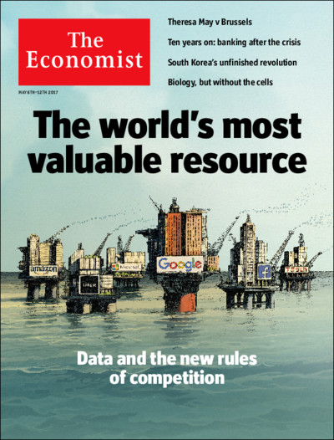
It’s Big (Data) …
‘New Oil’ amount of data increasing fast
Buzzwords: Analytics, Insights, Big Data, Data Science, Data Lakes, Machine Learning, AI
$189.1 Billion Market , Double-Digit Annual Growth Through 2022.
$7.5B for GitHub, $15.7B for Tableau
10s millions of people creating insight from data
More than software developers.
1 of 25 workers full time, significant part time.

Slide 5
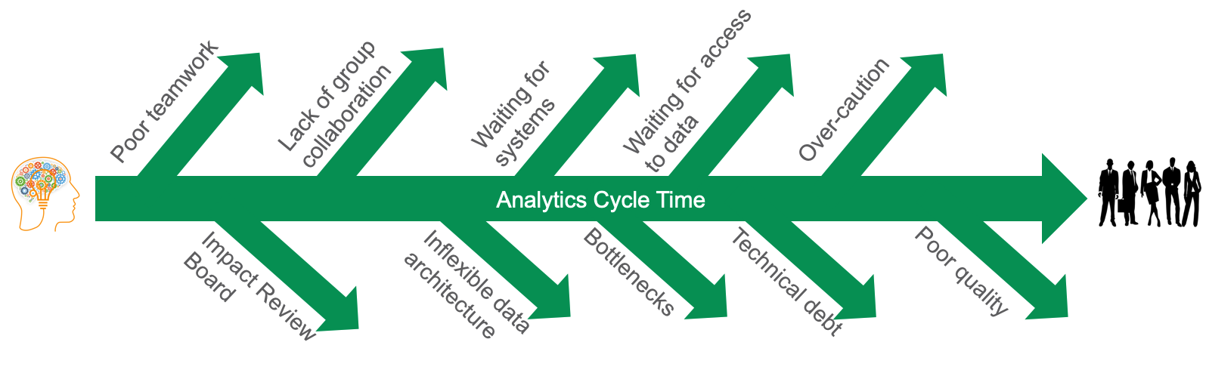
With a big problem: Failure
Rampant Failure:
87% of data science projects never get to production.
Data analytics investment up, yet “data driven” organizations down 37% to 31%
60% of all data analytic projects fail
79% of data projects have too many errors

Slide 6





Challenge: Data Analytics is like the US Auto Industry in the 1970s
Challenges:
Slow to add new features, rapidly address consumer requests, changing data sets
Errors in dashboards, reports, and data pipelines - lack of trust
Lacking pipeline visibility on premise, multi-cloud, etc.
Team morale
Deployment Latency
Weeks, Months
Dev
Prod
Production Errors
High Errors
Data Analytics Team
Current

Slide 7
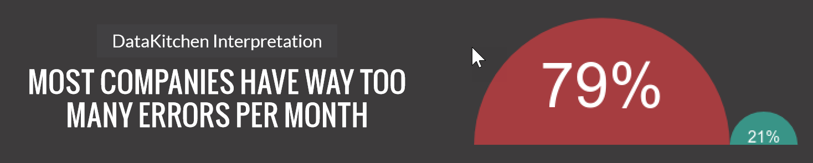
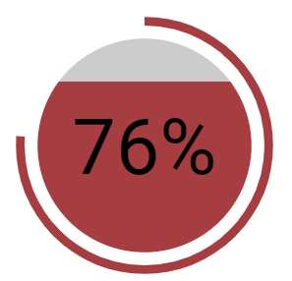

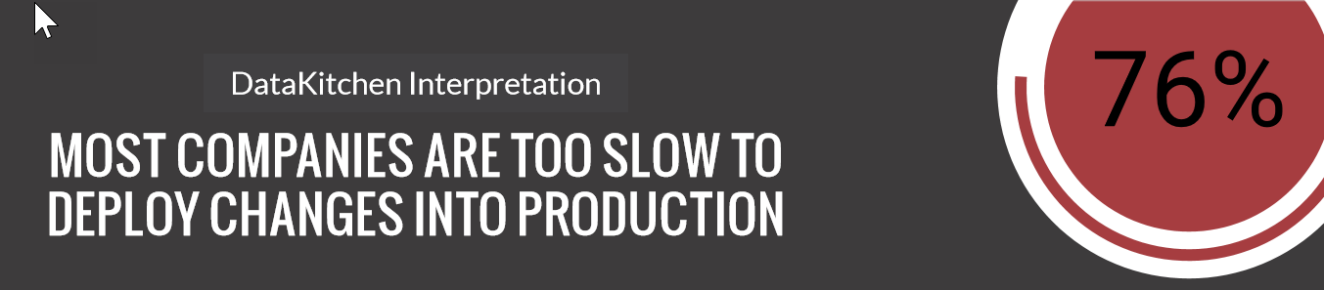



Data Analytics Today
Eckerson Survey (2019)
Eckerson Survey (2019)
Cycle
Time
ERROR Free DAYS
Team (s)
Collaboration
Process Measurement

Slide 8
Agenda
A BIG PROBLEM THAT CAN USE YOUR HELP
BY HAVING EMPATHY FOR A GROUP OF PEOPLE
THAT ARE SUFFERING
AND WHAT YOU KNOW CAN HELP THEM

Slide 9

Data teams took a different door …
They talk like you
They look like you
But early in their career they took the data analytics door, not the software door
… And have people and process problems that you can uniquely help!

Slide 10
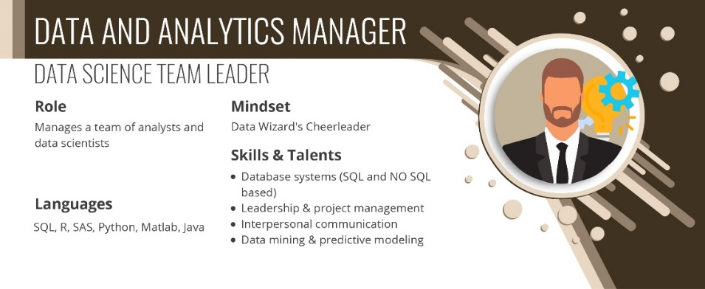
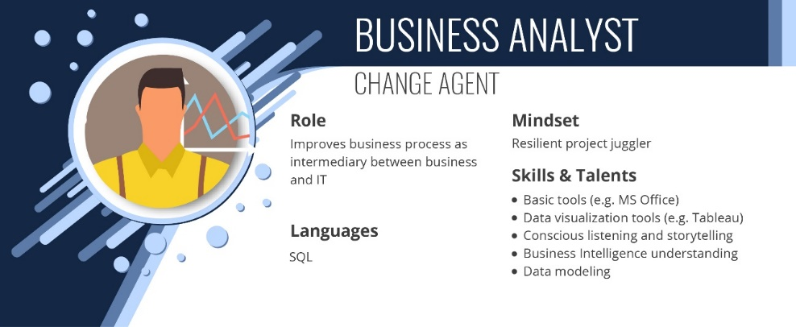
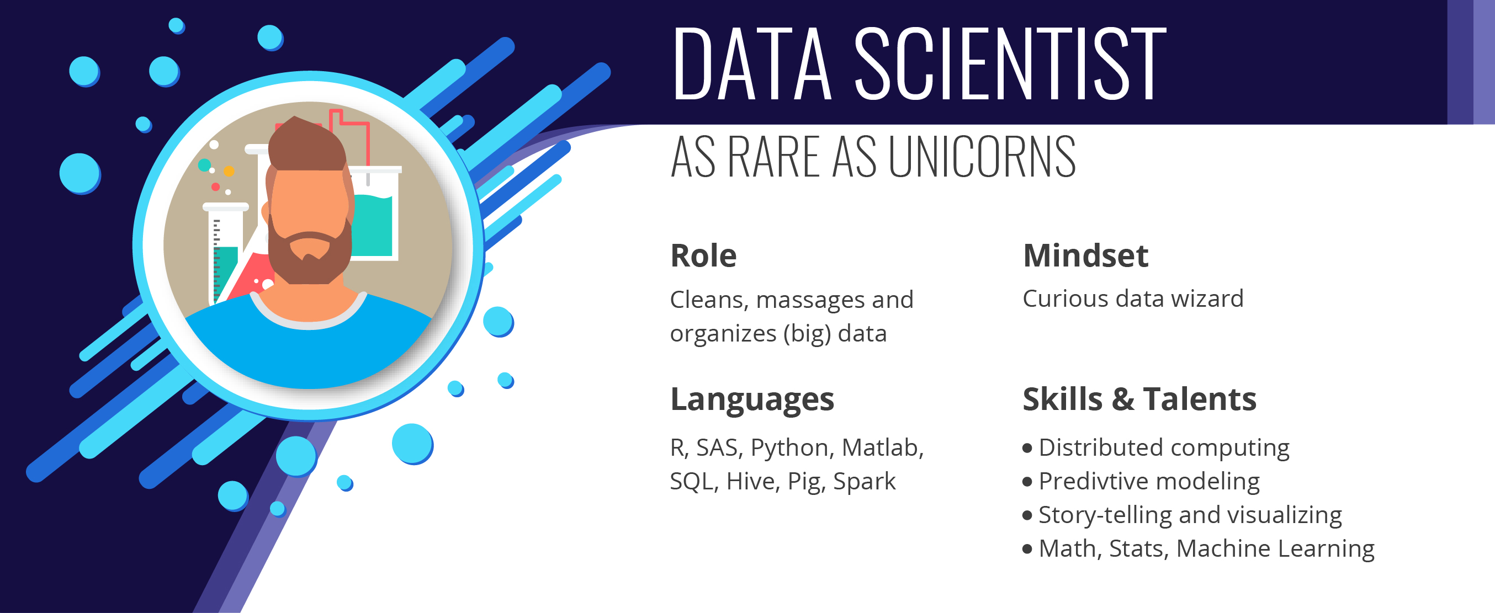
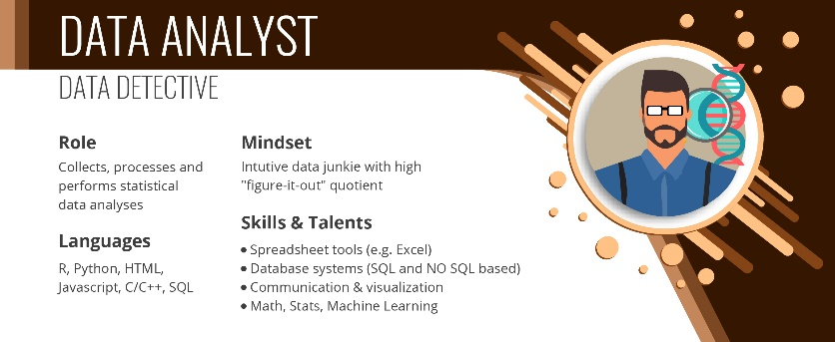
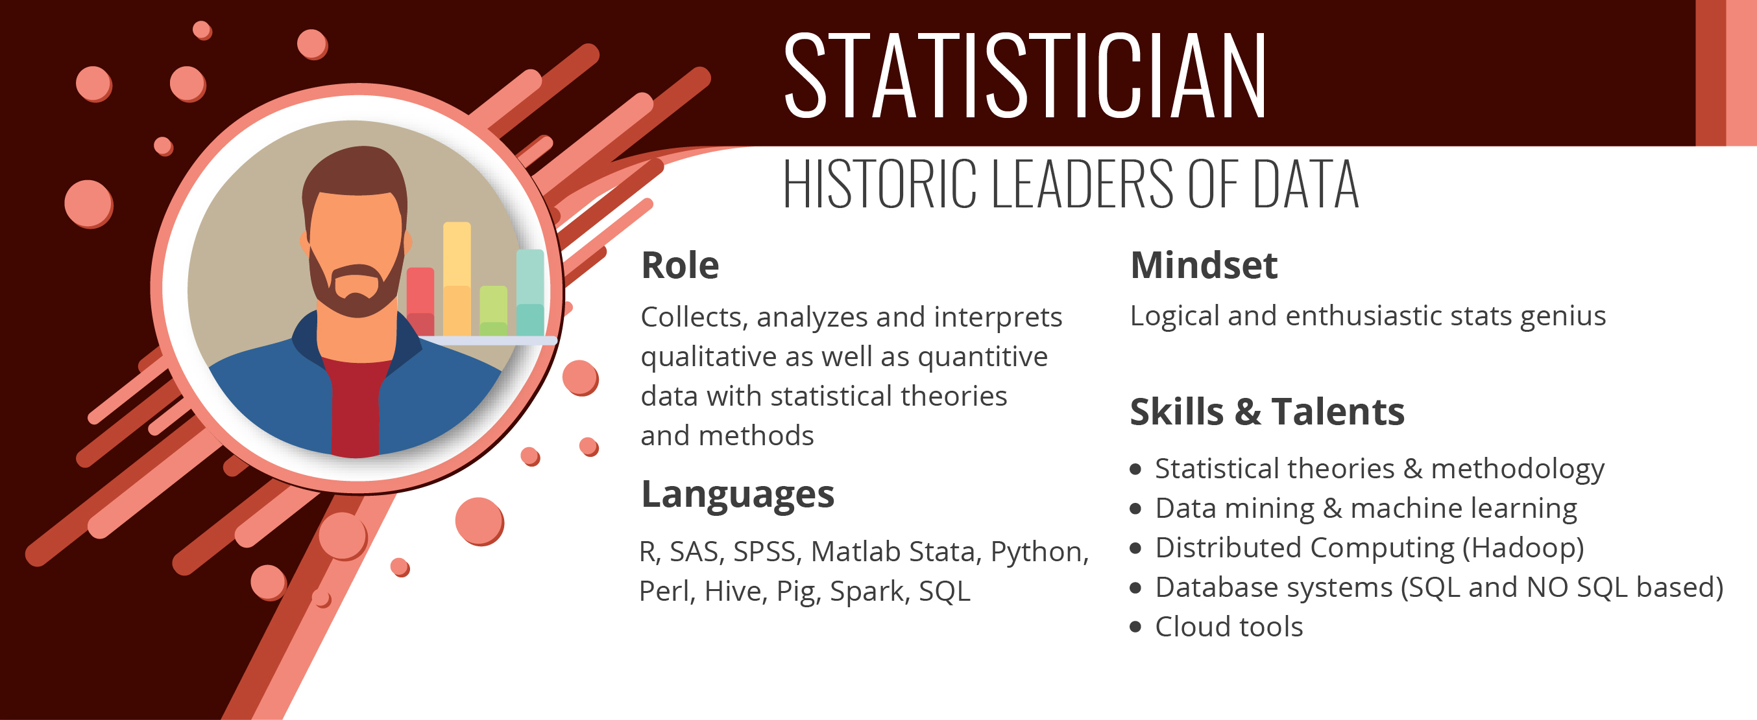
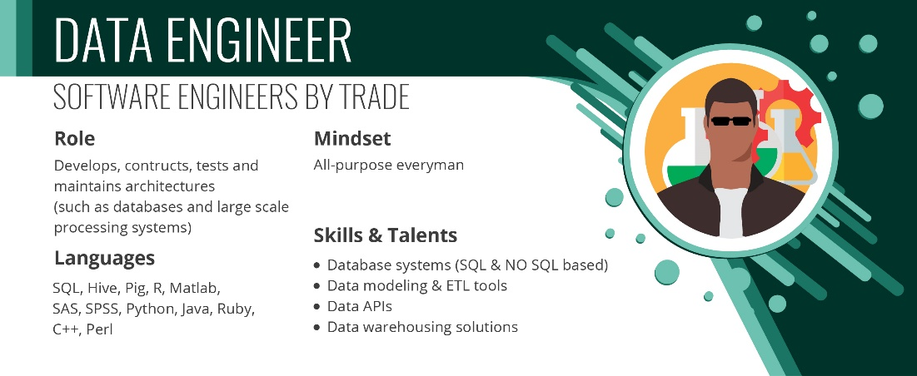
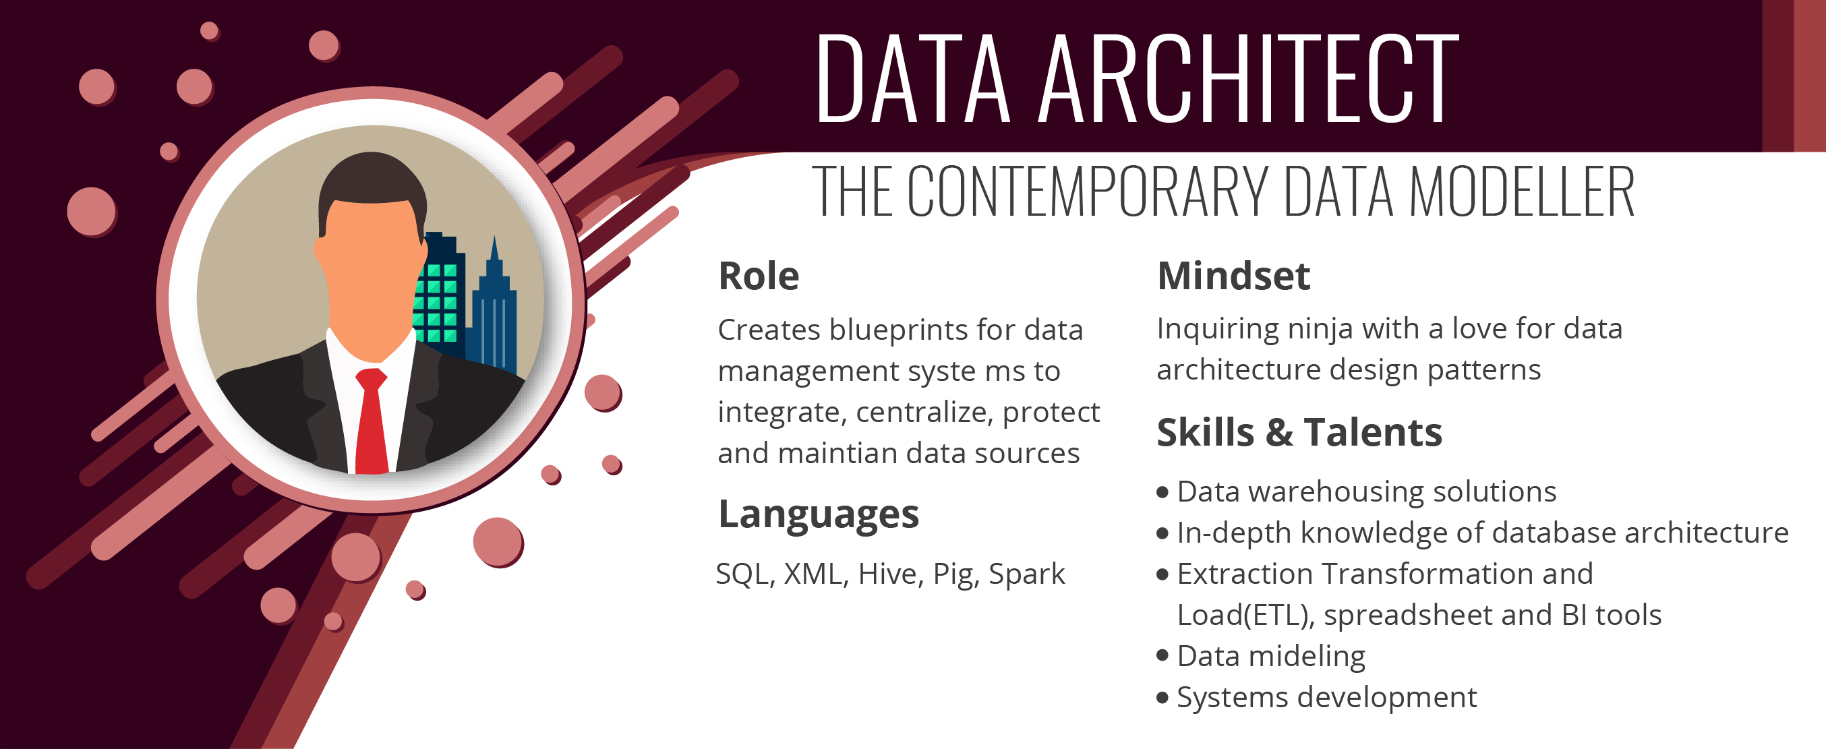
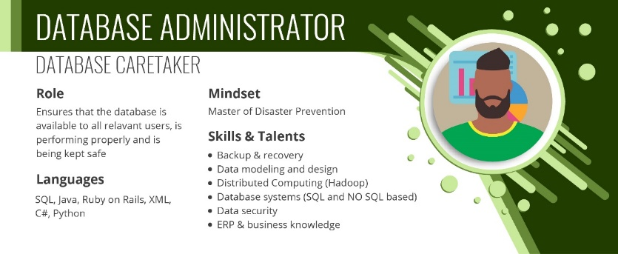
There are lots of people who work with data

Slide 11
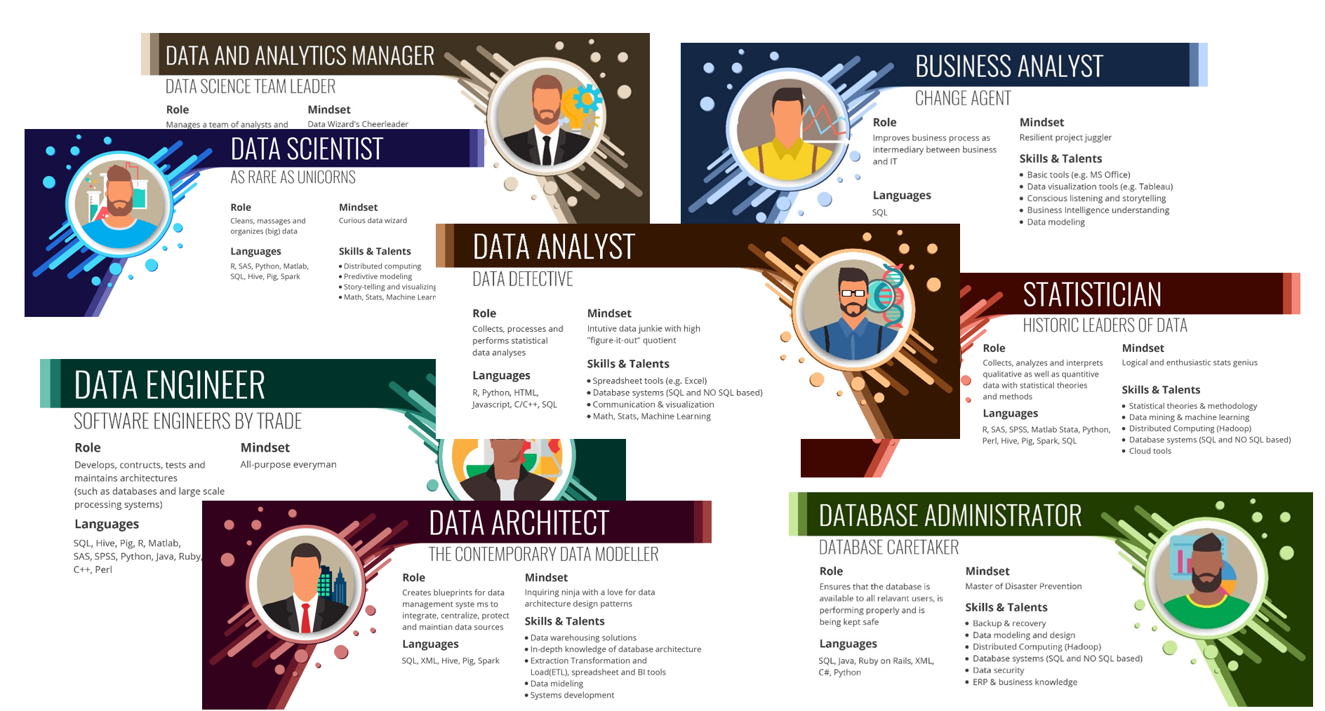
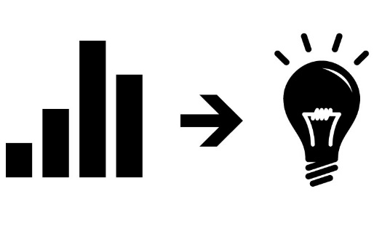
They Use Data From Transactional Systems And Create Analytical Systems
CRM
ERP
Supply Chain
Website
Financial
HR
Open Data
Syndicated
Databases
APIs
Files
Analytical Systems
Transactional
Systems/Sources

Slide 12
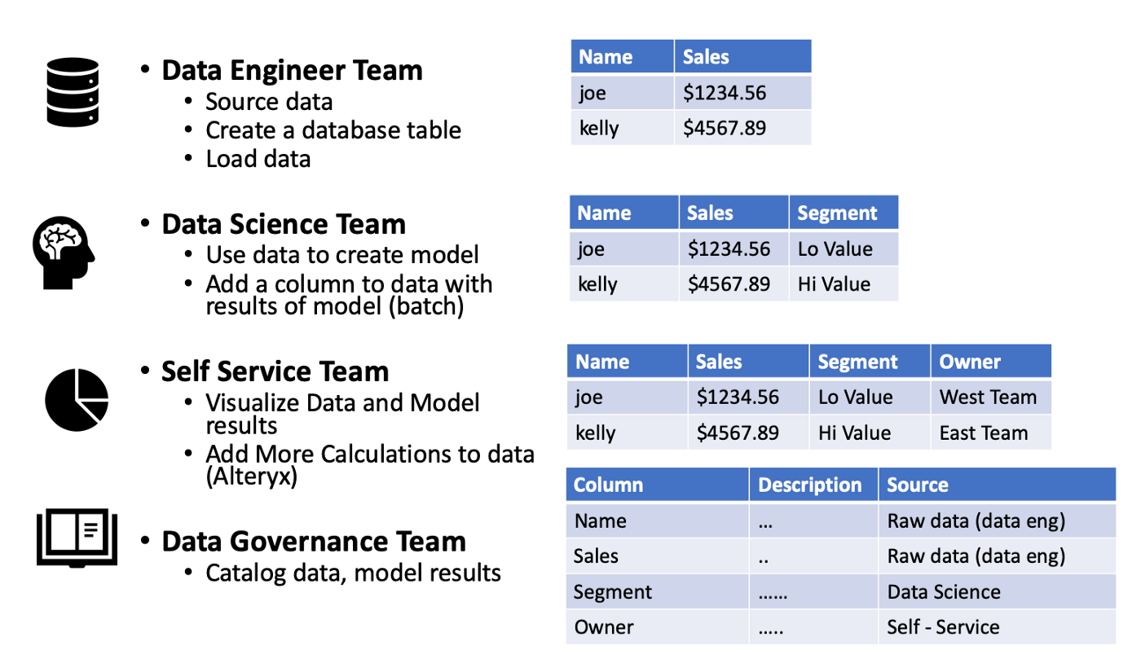
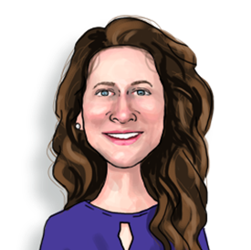





They work in teams

Slide 13
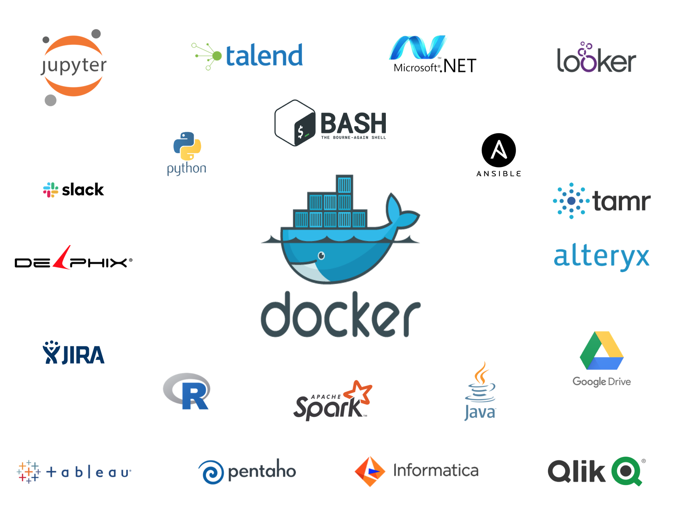
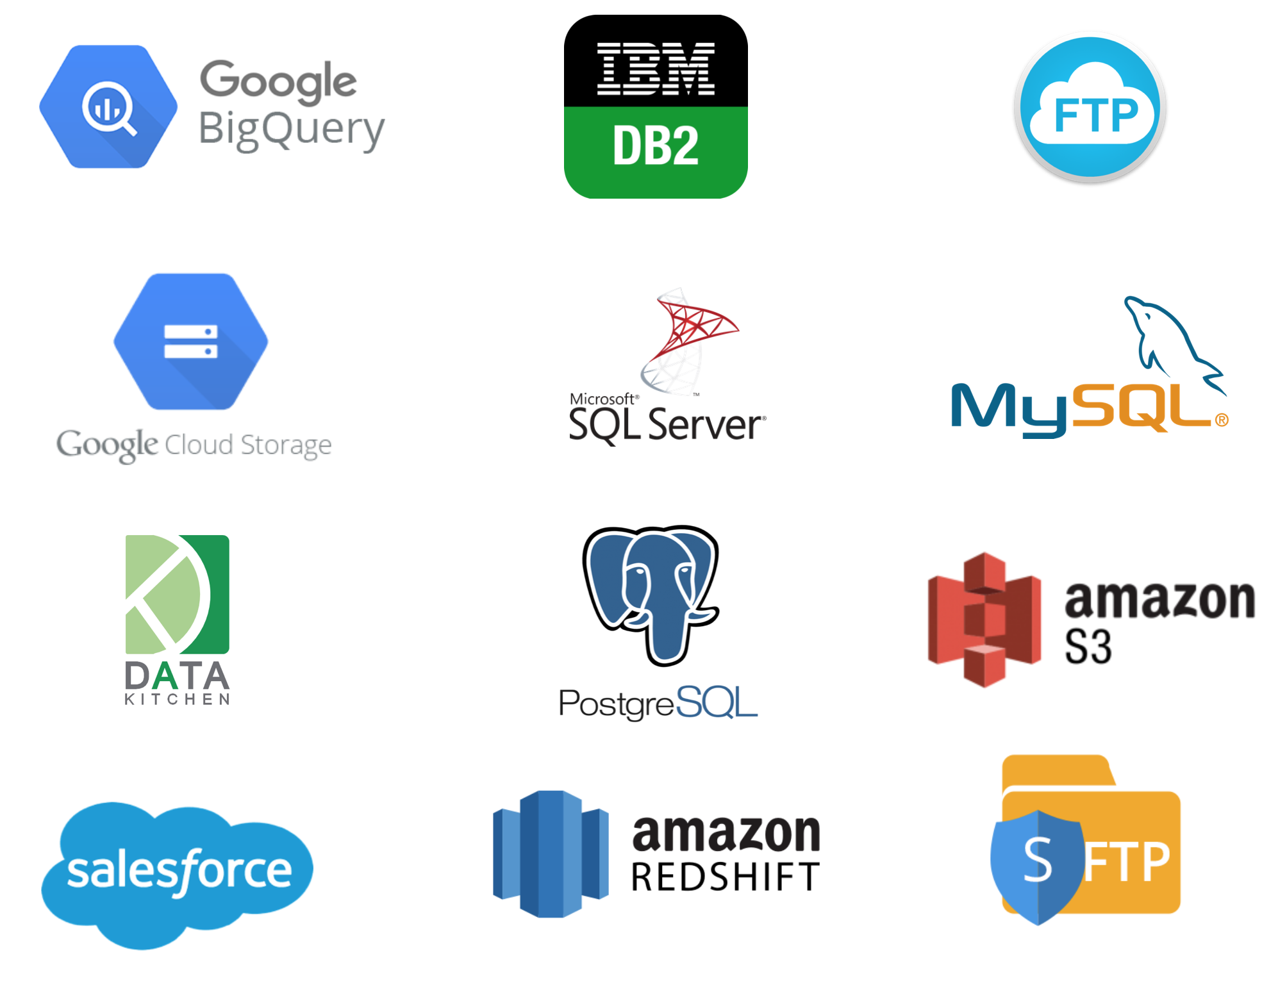
With a massive, fragmented toolchain
Data Visualization Tools (Tableau, etc)
Data Science Tools (Python, DataIku, etc.)
Data Catalog Tools (Alation, wiki)
ETL Tools (Informatica, Talend, etc.)
Databases (Redshift, SQL Server, etc.)
Data Sources and/or Data Lake

Slide 14
They work in teams together

Slide 15
They work in teams together

Slide 16
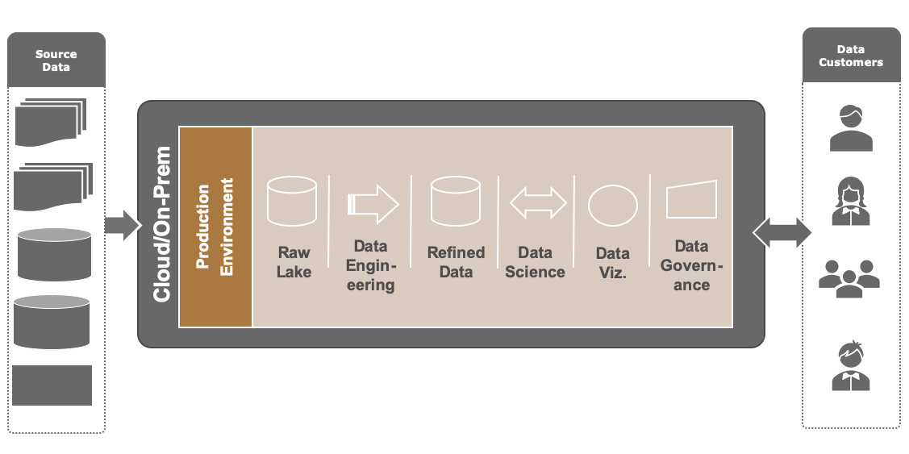
And they source data from internal and external system
CRM
ERP
Supply Chain
Website
Financial
HR
Open Data
Syndicated
Databases
APIs
Files

Slide 17
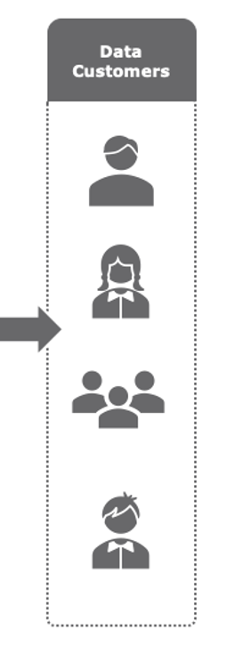
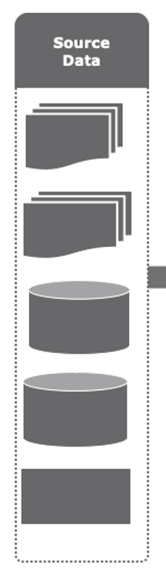
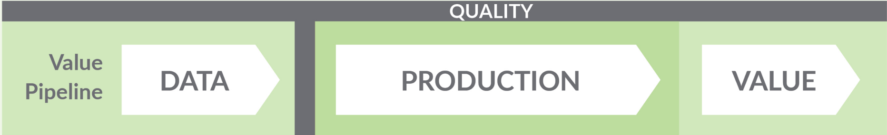






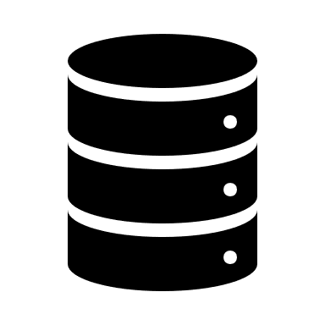


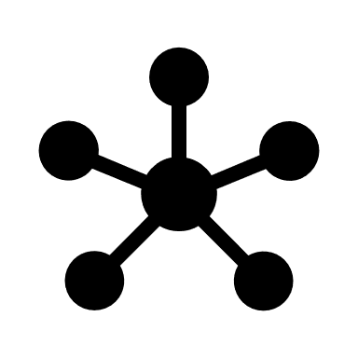







They run a ‘Factory’ of Insight
CRM
ERP
Supply Chain
Website
Financial
HR
Open Data
Syndicated
Databases
APIs
Files
Access: Python Code
Transform: SQL Code, ETL
Model:
R Code
Visualize: Tableau Workbook
Govern: Catalog

Slide 18
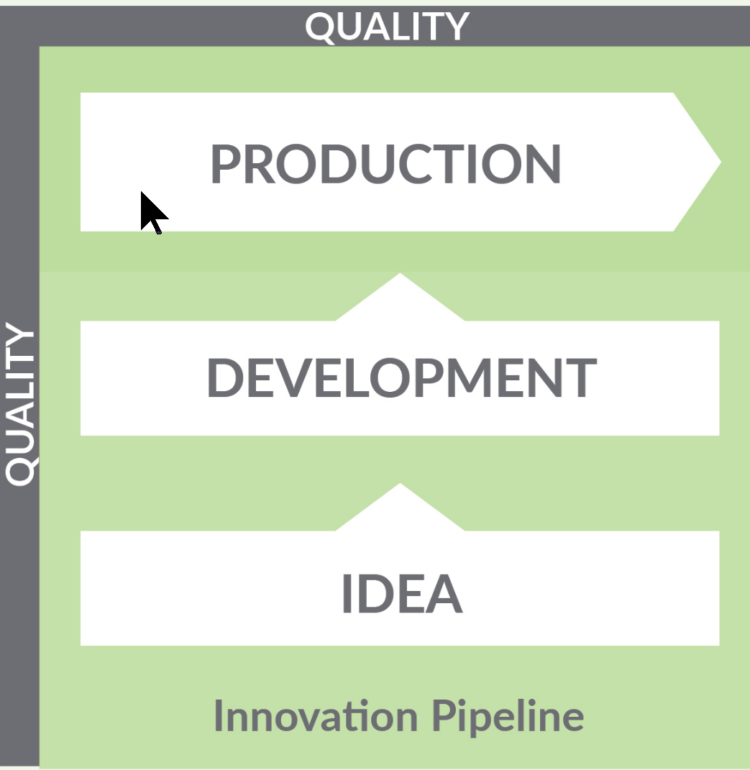

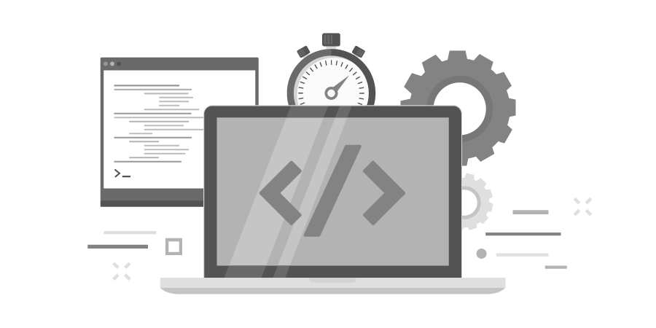



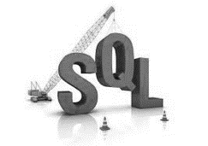




And need to deploy quickly from dev to production
Diverse Customers
Business
Customer
Products &
Systems
Diverse Team
Data
Engineers
Data
Scientists
Data
Analysts
Diverse Tools

Slide 19
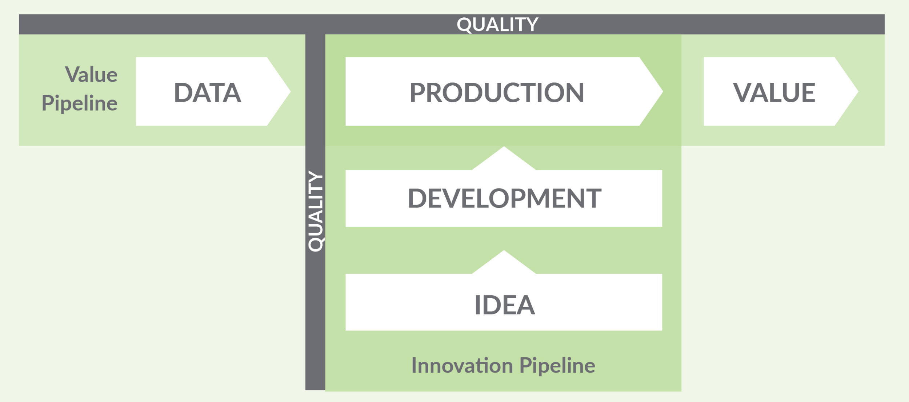
And need to do both simultaneously
Don’t want to learn about data quality issues from my customers
Don’t want break production when I deploy my changes

Slide 20
They may work for the same boss
Chief Data Officer
Chief Analytics Officer

Slide 21
Or not
CIO or CDO
Line of Business Executives
CEO

Slide 22
A many to many dev/ops relationship
Data Specific Production Team
Do Operations Themselves
Some other Ops team
“DEV”
“OPS”

Slide 23
A Cornucopia of Collaboration Complexity
DG
D
D
D
BI
D
D
D
P
D
D
DE
D
D
DS
P
P
P
Centralized Dev | Centralized Dev & Prod | Decentralized Dev | Decentralized Dev & Prod
How do we create together without conflicts? | How do we deploy safely and rapidly? | How to balance centralized control vs self service freedom? | How to reuse/incorporate what another team deployed?
Data Engineer & Data Scientist | Data Team and Production Team | Home Office Data Team and Line of Business Analysts | Multiple Data & Production Teams in Many Orgs
D
Development - Data Analytic Team
P
Production - Data Analytic Team
Notes:
How do we create together?
developer - developer (e.g. de – ds, kitchens, version control)
How do we deploy safely?
developer – production (kitchens, secrets)
How to balance centralized control vs self service freedom?
group – group (two different orgs, ingredients & kitchens)
How does my team reuse/incorporate what another team created?
group - group (same org, ingredients)
How can I make all my varied analytic tools work together?
tool chain - tool chain (meta - orchestration)

Slide 24
A Cornucopia of Collaboration Complexity
DG
D
D
D
BI
D
D
D
P
D
D
DE
D
D
DS
P
P
P
Centralized Dev | Centralized Dev & Prod | Decentralized Dev | Decentralized Dev & Prod
How do we create together without conflicts? | How do we deploy safely and rapidly? | How to balance centralized control vs self service freedom? | How to reuse/incorporate what another team deployed?
Data Engineer & Data Scientist | Data Team and Production Team | Home Office Data Team and Line of Business Analysts | Multiple Data & Production Teams in Many Orgs
D
Development - Data Analytic Team
P
Production - Data Analytic Team
Notes:
How do we create together?
developer - developer (e.g. de – ds, kitchens, version control)
How do we deploy safely?
developer – production (kitchens, secrets)
How to balance centralized control vs self service freedom?
group – group (two different orgs, ingredients & kitchens)
How does my team reuse/incorporate what another team created?
group - group (same org, ingredients)
How can I make all my varied analytic tools work together?
tool chain - tool chain (meta - orchestration)

Slide 25
A Cornucopia of Collaboration Complexity
DG
D
D
D
BI
D
D
D
P
D
D
DE
D
D
DS
P
P
P
Centralized Dev | Centralized Dev & Prod | Decentralized Dev | Decentralized Dev & Prod
How do we create together without conflicts? | How do we deploy safely and rapidly? | How to balance centralized control vs self service freedom? | How to reuse/incorporate what another team deployed?
Data Engineer & Data Scientist | Data Team and Production Team | Home Office Data Team and Line of Business Analysts | Multiple Data & Production Teams in Many Orgs
D
Development - Data Analytic Team
P
Production - Data Analytic Team
Notes:
How do we create together?
developer - developer (e.g. de – ds, kitchens, version control)
How do we deploy safely?
developer – production (kitchens, secrets)
How to balance centralized control vs self service freedom?
group – group (two different orgs, ingredients & kitchens)
How does my team reuse/incorporate what another team created?
group - group (same org, ingredients)
How can I make all my varied analytic tools work together?
tool chain - tool chain (meta - orchestration)

Slide 26
A Cornucopia of Collaboration Complexity
DG
D
D
D
BI
D
D
D
P
D
D
DE
D
D
DS
P
P
P
Centralized Dev | Centralized Dev & Prod | Decentralized Dev | Decentralized Dev & Prod
How do we create together without conflicts? | How do we deploy safely and rapidly? | How to balance centralized control vs self service freedom? | How to reuse/incorporate what another team deployed?
Data Engineer & Data Scientist | Data Team and Production Team | Home Office Data Team and Line of Business Analysts | Multiple Data & Production Teams in Many Orgs
D
Development - Data Analytic Team
P
Production - Data Analytic Team
Notes:
How do we create together?
developer - developer (e.g. de – ds, kitchens, version control)
How do we deploy safely?
developer – production (kitchens, secrets)
How to balance centralized control vs self service freedom?
group – group (two different orgs, ingredients & kitchens)
How does my team reuse/incorporate what another team created?
group - group (same org, ingredients)
How can I make all my varied analytic tools work together?
tool chain - tool chain (meta - orchestration)

Slide 27
A Cornucopia of Collaboration Complexity
DG
D
D
D
BI
D
D
D
P
D
D
DE
D
D
DS
P
P
P
Centralized Dev | Centralized Dev & Prod | Decentralized Dev | Decentralized Dev & Prod
How do we create together without conflicts? | How do we deploy safely and rapidly? | How to balance centralized control vs self service freedom? | How to reuse/incorporate what another team deployed?
Data Engineer & Data Scientist | Data Team and Production Team | Home Office Data Team and Line of Business Analysts | Multiple Data & Production Teams in Many Orgs
D
Development - Data Analytic Team
P
Production - Data Analytic Team
Notes:
How do we create together?
developer - developer (e.g. de – ds, kitchens, version control)
How do we deploy safely?
developer – production (kitchens, secrets)
How to balance centralized control vs self service freedom?
group – group (two different orgs, ingredients & kitchens)
How does my team reuse/incorporate what another team created?
group - group (same org, ingredients)
How can I make all my varied analytic tools work together?
tool chain - tool chain (meta - orchestration)

Slide 28
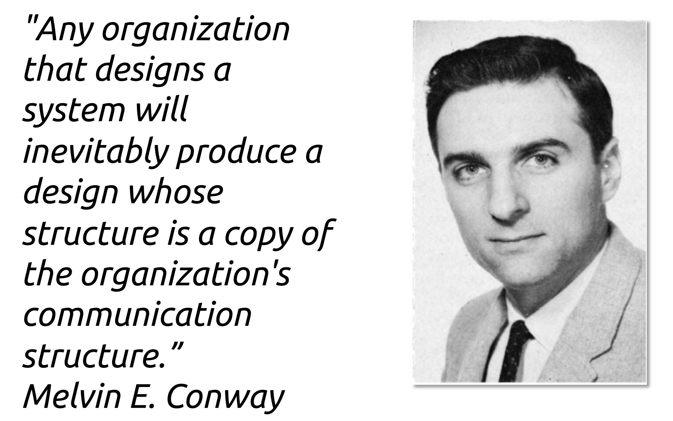
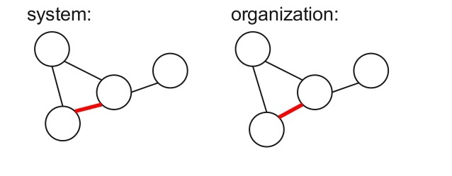
Conway’s Law and Data Pipelines
Data Analytics Follows Conway's Law
The structure of how teams are organized to do Data Science, Data Engineering, Analytics, and Production is reflected in their data pipelines.

Slide 29
Agenda
A BIG PROBLEM THAT CAN USE YOUR HELP
BY HAVING EMPATHY FOR A GROUP OF PEOPLE
THAT ARE SUFFERING
AND WHAT YOU KNOW CAN HELP THEM

Slide 30
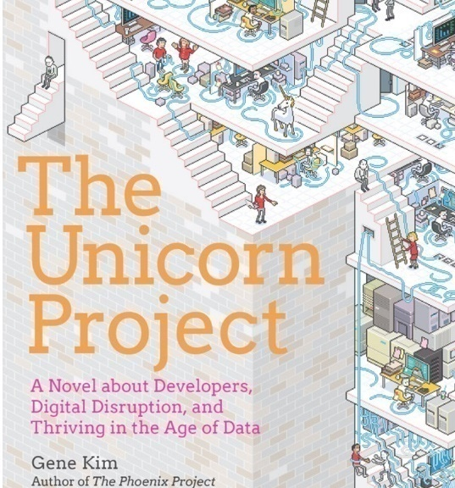
Your Data Nerd Friends Are Suffering
Hero culture
Fear culture
Insanely high error rate
Complete lack of automated testing
Deploy to product rates of months
Lots of hope, heroism and fear.
Technology Review Boards
Project Panther! It’s a subplot in Gene’s new book for a reason

Slide 31
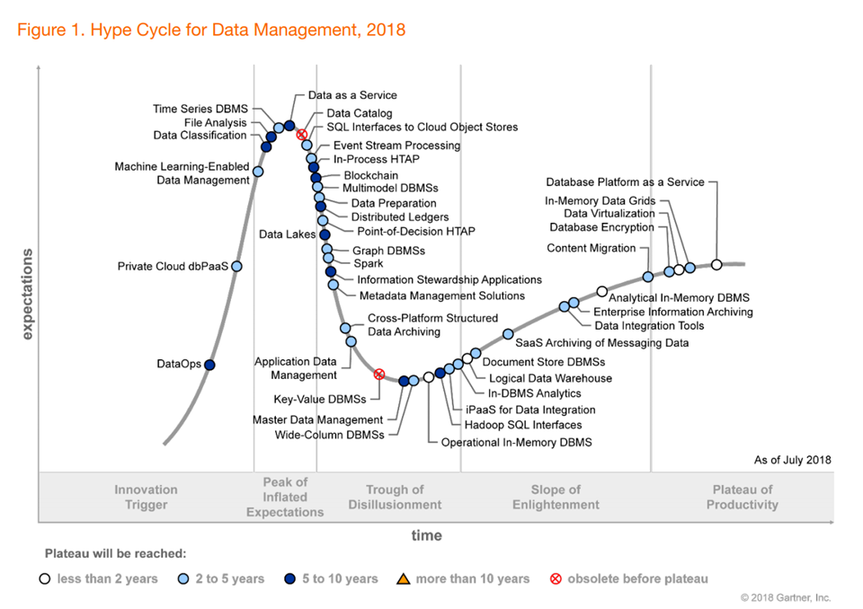
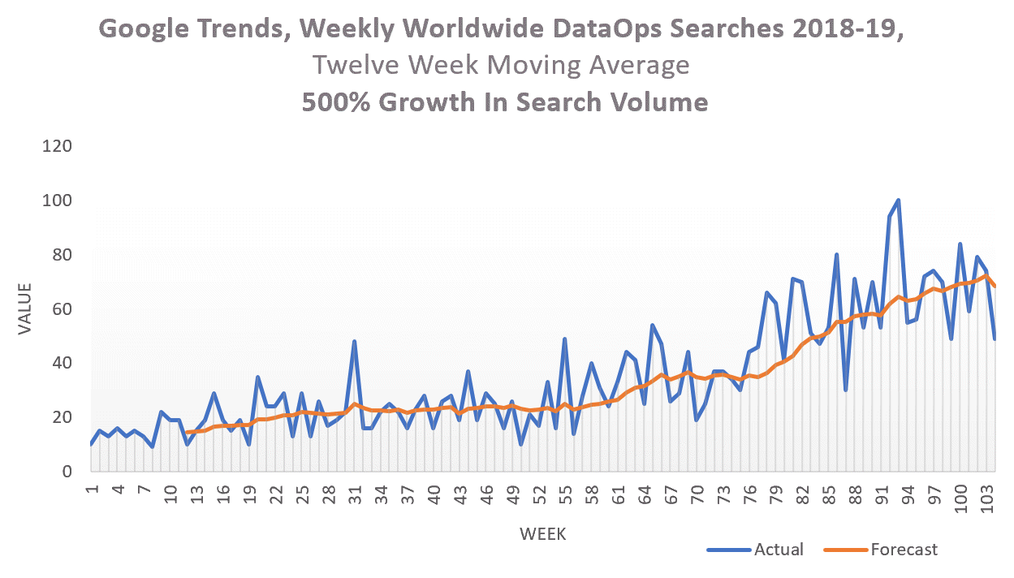
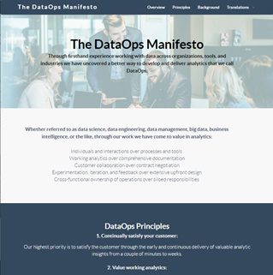
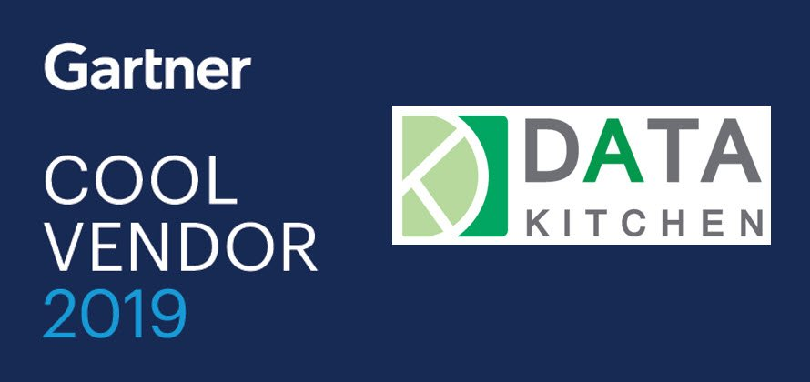
DataOps is having a moment
DataOps Manifesto: 10000 signatures
Gartner Hype Cycle in late 2018
Increased market adoption of DataOps principles by leaders of data and analytic teams
Gartner Hype Cycle
500% Search Growth

Slide 32
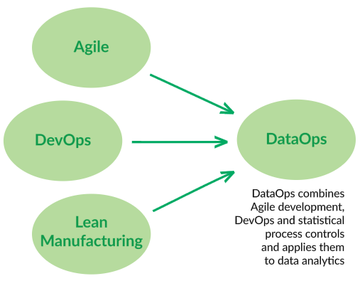
DataOps – Transformative to Data Analytics
DataOps is a set of technical practices, cultural norms, and architecture that enable:
Rapid experimentation and innovation for the fastest delivery of new insights to our customers
Low error rates
Collaboration across complex sets of people, technology, and environments
Clear measurement and monitoring of results
People,
Process,
Organization
Technical
Environment
Source: Gartner

Slide 33
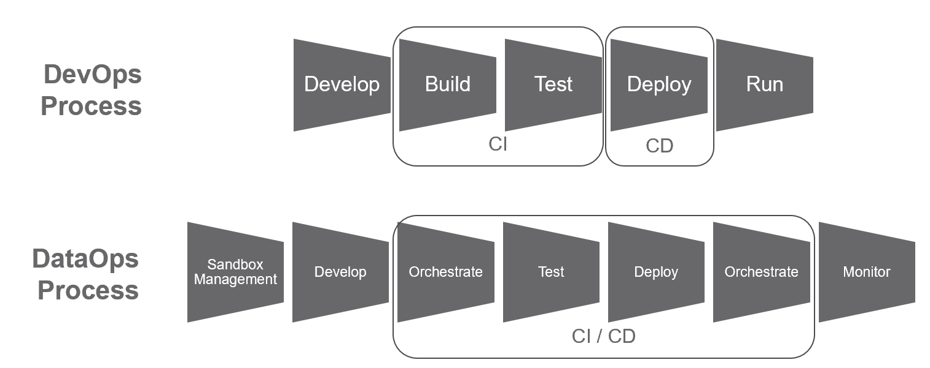
DevOps vs DataOps:
Different Process, Different People and Expectations
DevOps 1:1 DataOps Many:Many
Multiple ‘Dev’ and ‘Ops’ groups
DataOps Views Data Analytics as ‘Factory’
Multi-Tool Orchestration Testing, Monitoring and Statistical Process Control
DataOps Has Additional Development Complexities

Slide 34



DataOps Benefit: Faster, Better & Happier
Deployment Latency
Weeks, Months
Hours & Mins
Dev
Prod
Dev
Prod
Production Errors
High Errors
Low Errors
Data Analytics Team
Before DataKitchen
After DataKitchen

Slide 35

Best IN calss Can Do It All With DataOps
$
Cycle
Time
ERROR Free DAYS
TeAm (s)
Collaboration
Process Measurement
Cost &
Productivity
UNHAPPY
CUSTOMERs

Slide 36
Agenda
A BIG PROBLEM THAT CAN USE YOUR HELP
BY HAVING EMPATHY FOR A GROUP OF PEOPLE
THAT ARE SUFFERING
AND WHAT YOU KNOW CAN HELP THEM

Slide 37

DevOps Leaders
Join the DataOps Movement

Slide 38
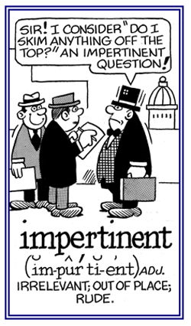
Ask your data analytic teams impertinent questions
Are you using source control for your work?
How many automated tests to you have in production?
Do you have regression, functional or unit tests for you work?
How long does it take to deploy ETL/models/BI report from development to production?
Do you have automated deployment?
How up to date is your development environment?
How often are your business users finding errors in the data?

Slide 39

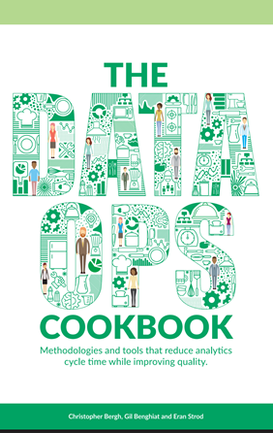
Learn More About DataOps and DataKitchen
Decrease Cycle Time of Innovation & Change
Lower Error Rates In Production
Improve Collaboration: Inter and Intra Team
Sign The DataOps Manifesto:
http://dataopsmanifesto.org
Free DataOps Cookbook: https://www.datakitchen.io/dataops-cookbook-main.html
Excerpt from Gene’s Unicorn Project Book on DataOps
https://www.datakitchen.io/unicorn-project.html
Measure Your Process: Lower Cost and More Insight

Slide 40

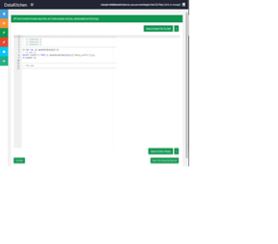
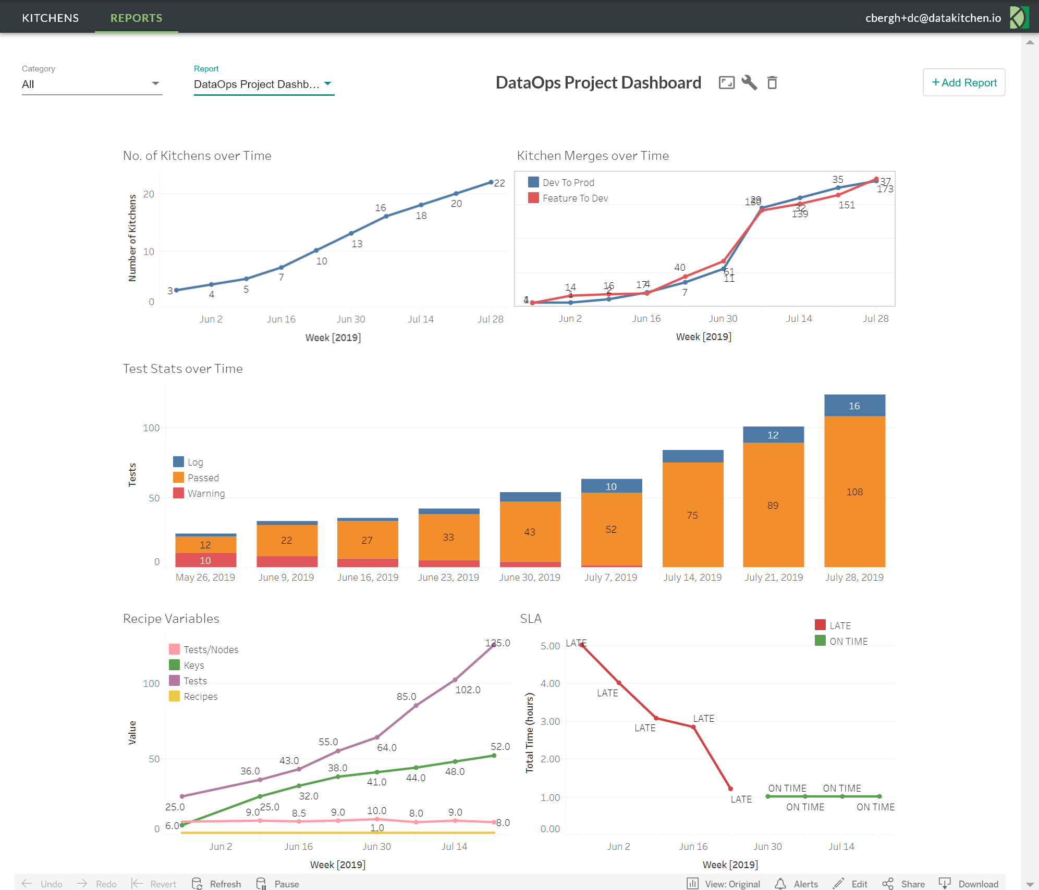
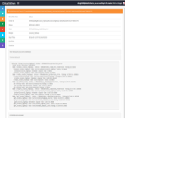
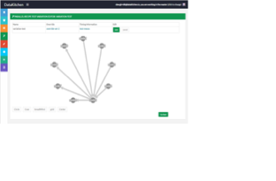
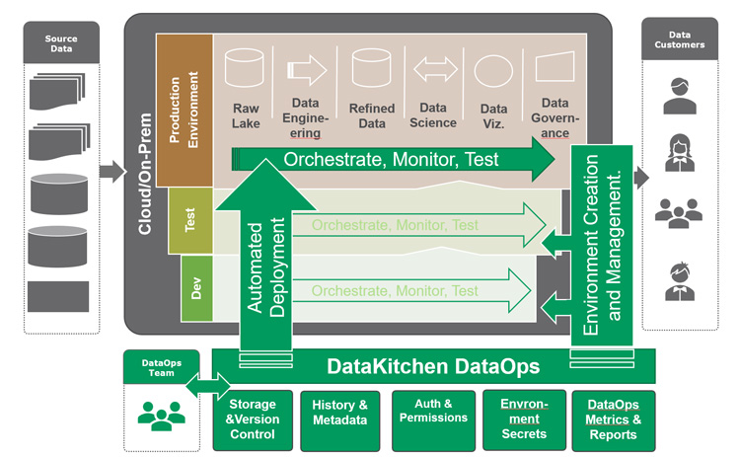
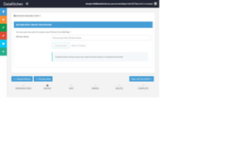
Accelerate DataOps With DataKitchen Software
Decrease Cycle Time of Innovation & Change
Lower Error Rates In Production
Improve Collaboration: Inter and Intra Team
DataKitchen DataOps Software Platform that delivers new business insights by enabling the development and deployment of innovative, high quality data analytic pipelines. Rapidly
Measure Your Process: Lower Cost and More Insight

